Slide 1


TIME SERIES FORECASTING
ARMA MODEL
Presented by: Nihal Kumar

Slide 2
Introduction
“Let data speak themselves”
Time series forecasting is the process of analyzing time series data using statistics and modeling to make predictions and inform strategic decision-making.
Forecasting insight about which outcomes are more likely— or less likely
Applications including: weather forecasting, climate forecasting, economic forecasting, healthcare forecasting engineering forecasting, finance forecasting, retail forecasting, business forecasting, environmental studies forecasting, social studies forecasting, and more.

Slide 3
Assumptions
ARMA model is based on the assumption that the time series (variable) under study is “STATIONARY”.
A stationary time series is one whose properties do not depend on the time at which the series is observed.
If the variable is not stationary then we have to take first difference to make variable stationary.

Slide 4

INTRODUCTION
The term ARMA stands for Auto Regressive Moving Average.
ARMA model is combination of AR and MA model.
i.e ARMA = AR + MA
Here AR = Auto Regressive
MA = Moving Average

Slide 5
AR(Auto regressive ) model
The notation AR(p) refers to the autoregressive model of order p. The AR(p) model is written
y_{t}= c + ε_{t} + a₁y_{t-1}+ a₂y_{t-2} +.......…+ a_{p}y_{t-p}
a₁ a₂ ……….a_{p} are the Auto Regressive coefficients
y_{t} is the value of the time series
ε_{t} is the error associated and c is a constant

Slide 6
AR(Auto regressive ) model (Contd..)
Some constraints are necessary on the values of the parameters so that the model remains stationary . For example, processes in the AR(1) model with | y1| >1 are not stationary
Example :-
AR(1) with yt=18−0.8yt−1+εt AR(2)with yt=8+1.3yt−1−0.7yt−2+εt

Slide 7
MA(Moving Average ) model
Rather than using past values of the forecast variable in a regression, a moving average model uses past forecast errors in a regression-like model.
The notation MA(q) refers to the moving average model of order q:
y_{t}= μ + ε_{t} + m₁ε_{t-1}+ m₂ε_{t-2} +.......…+ m_{q}ε_{t-q}
m₁ m₂ ……….m_{p} are the Moving Average coefficients
y_{t} is the value of the time series
ε_{t} is the error associated and μ is the expectation of y_{t}

Slide 8
MA(Moving Average ) model(Contd..)
Example :-
MA(1) with yt=20+εt+0.8εt−1
MA(2) with yt=εt−εt−1+0.8εt−2

Slide 9
ARMA Model
The notation ARMA(p, q) refers to the model
with p autoregressive terms and q moving-average terms. This model contains the AR(p) and MA(q) models
ARMA(p,q) model
y_{t}= β + a₁y_{t-1}+ a₂y_{t-2} +....+ a_{p}y_{t-p}+ ε_{t} + m₁ε_{t-1}+ m₂ε_{t-2} +....+ m_{q}ε_{t-q}
(p,q) is called as the order of the ARMA model
m₁ m₂ …m_{p} and a₁ a₂ …a_{p} are the ARMA coefficients.
y_{t} is the value of the time series.
ε_{t} is the error associated and β is a constant.

Slide 10
Box-Jenkins (BJ) Methodology :
_{Steps:}
_{(1) Identification}
_{(2) Model estimation}
_{(3) Diagnostic test}
_{Then we can do forecasting}

Slide 11
Identification
The value of p and q in ARMA(p,q) model is determind by some criterion such as partial auto correalation Function (PACF) and Autocorrelation Function (ACF).
PACF : It gives the correlation between the dependent variable and its lag values while keeping the effect of shorter lags constant. The first correlation value for Y­t & Yt-1 then Yt &Yt-3 and so forth. The correlation between Yt & Yt-2 does not include the effect of Yt & Yt-1 , That is why it is known as partial Autocorrelation Function.

Slide 12
Identification(Contd..)
ACF : It gives correlation between the dependent variable and the same variable with different lags, but the effect of shorter lags in not kept constant. This means that the effect of shorter lag is included in the numbers given with the autocorrelation functions. The correlation between Yt &Yt-2 includes the effect of correlation between Yt & Yt-1. This is the opposite of the PACF used earlier where the effect of shorter lags is not included.
We determine the optional number of lagged error terms to include in a moving average model by its autocorrelation function (ACF) . ACF is different from PACF used with autoregressive model

Slide 13
Model’s Estimation
After finding p (PACF) and q(ACF) here AR(p) and MA(q) have been found. Keep this think in mind that we have to run all possible models of AR(1) and MA(1) for forecasting like.
eg. ARMA(p,0) ,ARMA(p,q) and ARMA(0,q)
We will choose model which has most of following features 1.significant coefficient
2. SIGMASQ(minimum) – which shows the volatility
3. Adj. R2 (Maximum)
4.AIC(Minimum)
5. SIC(Minimum)

Slide 14
Diagnostic test
Error term should be stationary. We can check it through it through conventional unit root test or Q-statistics.
If error is not stationary at level then we have to repeat all above steps. If this is not the case then go for Forecasting
After running regression model , we can forecast future values of Forcast variable .

Slide 15
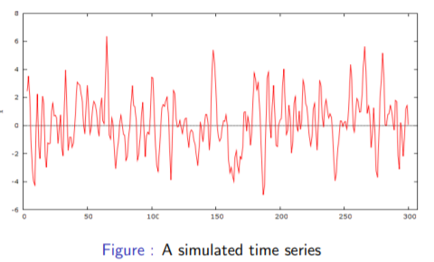
EXAMPLE..
Following is graph of time series x program.

Slide 16
CONTD..
We want to build a ARMA model for this time series so that we can forecast. Primitive step would be check whether data is stationary.
Our time series seems the realization of a stationary process with zero mean, thus we can look at sample autocorrelation and partial autocorrelation function to establish the orders p and q of the ARMA model.

Slide 17
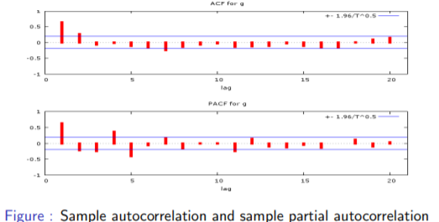
CONTD..

Slide 18
CONTD..
Since the SACF cuts off after lag 2 and the SPCAF follows a damped cycle, an MA(2) model xt = ut + θ1ut−1 + θ2ut−2, ut ∼ WN(0, σ2 ) seems appropriate for the sample data.
Table reports the result of the ML estimation.
Variable | Coefficient | St. error | T statistic | p-value
Theta 1 | 1.68559 | 0.0456203 | 36.9481 | 0.000
Theta 2 | 0.883683 | 0.0492842 | 17.9303 | 0.00

Slide 19
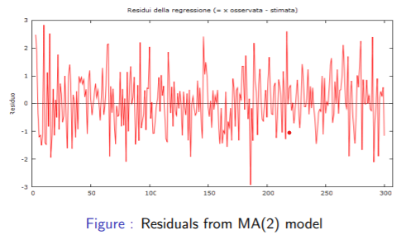
CONTD..
Now, we consider the graph of the residuals
Figure : Residuals from MA(2) mode

Slide 20
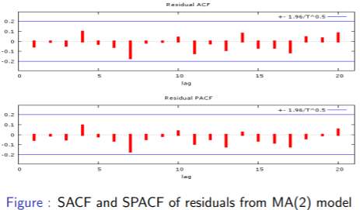
CONTD..

Slide 21
CONTD..
By analysing the SACF and SPACF of residuals presented in figure, we note that any term isn’t significant and Q25 = 16.4450 do not indicate any autocorrelation in the residuals. They can be assimilate to a white noise process.
We conclude that the MA(2) model defined by x_{t} = u_{t} + 1.686u_{t−1} + 0.884u_{t−2}, u_{t} ∼ WN(0, 0.94) appear to fit the data very well.

Slide 22
REFFERENCES
https://youtu.be/kaXKnjCvEUQ
https://en.wikipedia.org/wiki/Autoregressive%E2%80%93moving-average_model
http://www.phdeconomics.sssup.it/documents/Lesson15.pdf
Box-Jenkins (ARMA and ARIMA) Method with EViews Part (2/2) - YouTube

Slide 23


THANK YOU!

